Slide 1
WELCOME
To
Aghora Design Academy

Slide 2
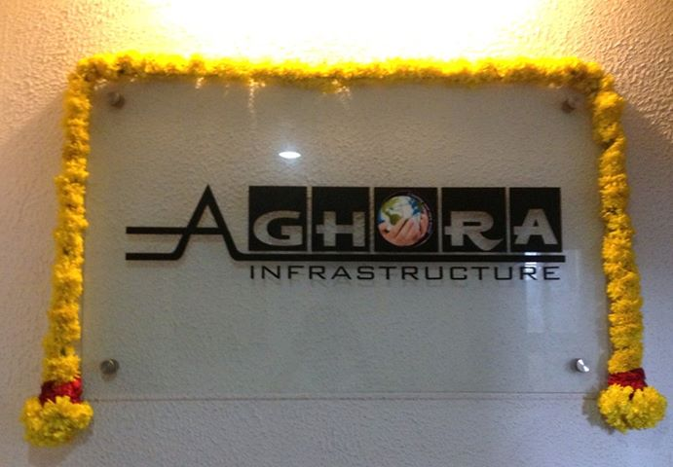
Aghora Design Academy

Slide 3
Aghora Design Academy is a training Institute run by Aghora Infrastructure Pvt. Ltd is a engineering service provider in the
field of designing, construction and training, specialized in hvac, electrical , plumbing, fire fighting, structural and building management system.

Slide 4
Our Company holds an Academy for Designing and Draughting with a vision to offer Excellent training in
HVAC Designing & Draughting
Electrical Designing & Draughting
Plumbing Designing & Draughting
Firefighting Designing & Draughting
Structural Designing & Draughting
Building Management System

Slide 5
Which is a right mean to achieve excellence in handling and implementation of global standards for construction and a vibrant practical knowledge through site.

Slide 6
We empower our candidates with advanced draughting software REVIT and other software packages. We also conduct technical seminars handled by technical experts from Multi-National Companies.

Slide 7
Our placement cell also helps you to get better opportunities. In addition to that our trained professionals also get AUTODESK authorized training certificate for Draughting

Slide 8
Contact details: AGHORA Design Academy (Contact Advertiser) 9388988988, 0474-3220988 2nd Floor, Salihas Complex, Near Benziger Hospital, Beach Road, Kollam
http://aghoragroup.com

